Slide 1


BRAIN TUMORs

Slide 2
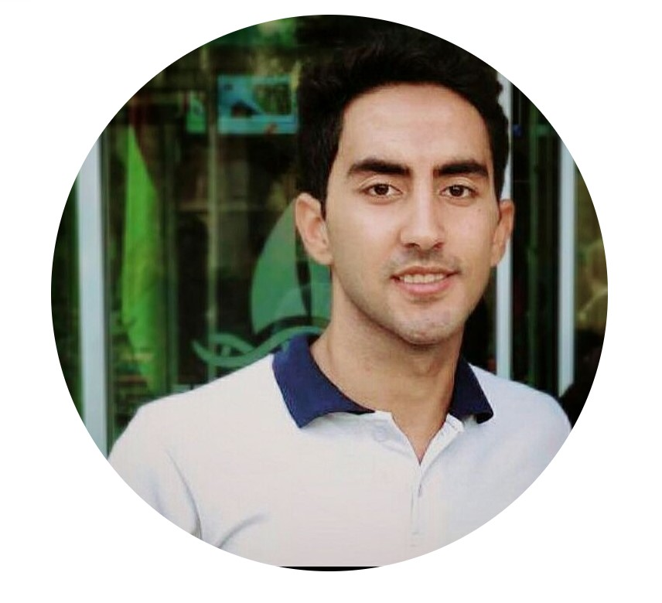



Visual00h
Abdullah Wagih
Marwan Ahmed
Shireen Soliman
Kareen Magdy

Slide 3
Agenda
01
05
INTRODUCTION
USER INTERFACE
02
04
PROBLEM STATEMENT
ANALYSIS
03
PROPOSED SOLUTION
06
FUTURE WORK

Slide 4
01
FIRST SECTION

Slide 5
01
INTRODUCTION
A Brain tumor is considered as one of the aggressive diseases, among children and adults. Brain tumors account for 85 to 90 percent of all primary Central Nervous System (CNS) tumors.
Brain cancer mortality rate - 75%
Due to the importance of the topic of tumors, many international bodies have tried to help increase the accuracy of diagnosis in the hope of increasing the success rate of treatment and adapting many medical cases with technological capacity

Slide 6
02
SECOND SECTION

Slide 7
02
PROBLEM STATEMENT

Slide 8
Brain Tumors are classified as: Glioma Tumor, Meningioma Tumor, Pituitary Tumor, etc.
In an attempt to keep pace with these capabilities, we thought of adapting many models of artificial intelligence, so we thought of models that have the ability to predict the presence of tumors through medical examinations such as MRI and all medical examinations that help discover those tumors of all kinds.

Slide 9
Magnetic resonance imaging (MRI) is the imaging technique used to diagnosing brain tumor disease. Early diagnosis of brain tumors is an essential task in medical work to find out whether the tumor can potentially become cancerous. Deep learning has been applied on three sequences of MRI ( T1, T2, FLAIR)

Slide 10
03
THIRD SECTION

Slide 11
AVAILABLE SOLUTION
03

Slide 12
PROJECT SETUP
The project had solved two challenges:
RSNA-MICCAI Brain Tumor Radiogenomic Classification Competition
Figshare Brain Tumor Dataset
Project goals is to create an AI model to help doctors to diagnose brain tumor cases.

Slide 13
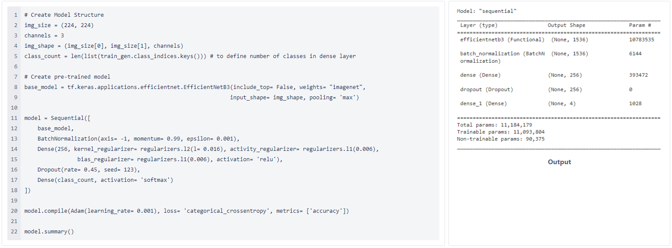
proposed solution
EfficientNetB3 architecture with accuracy 99%

Slide 14
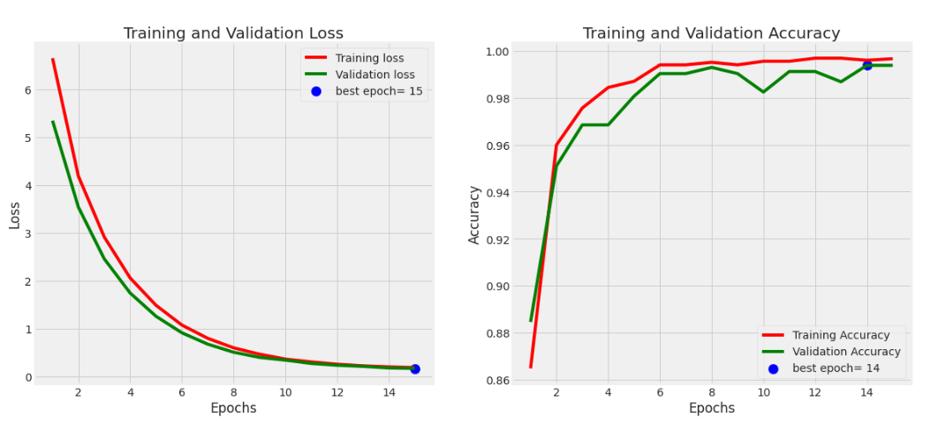
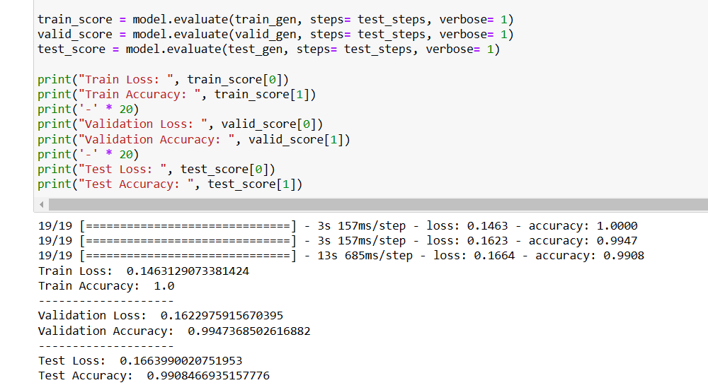
Training History
Model Evaluation

Slide 15
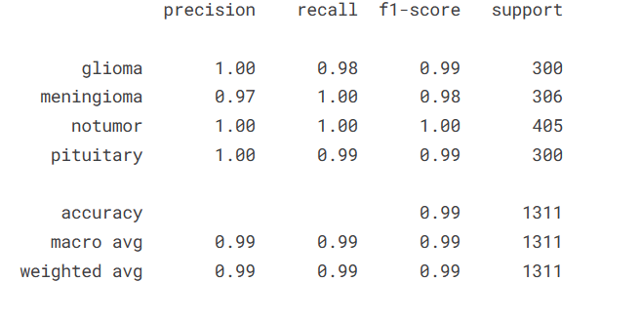
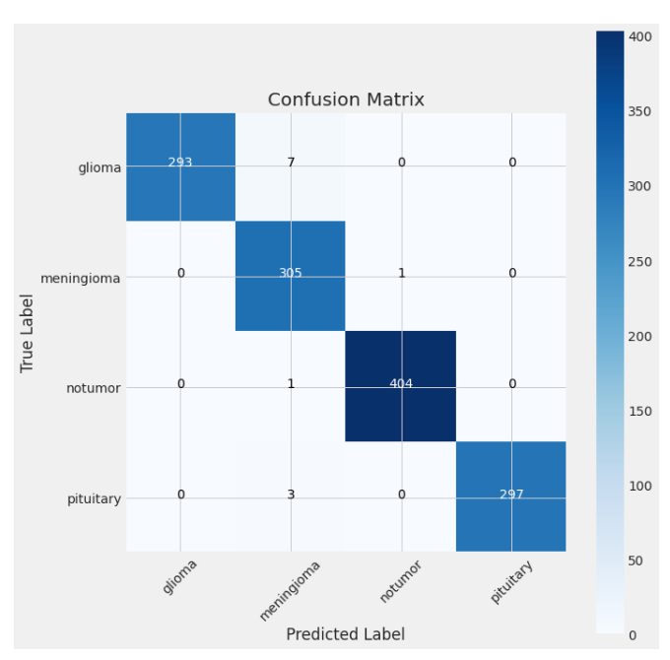
Classification Report& Confusion Matrix

Slide 16

SDGS

Slide 17
04
business model

Slide 18
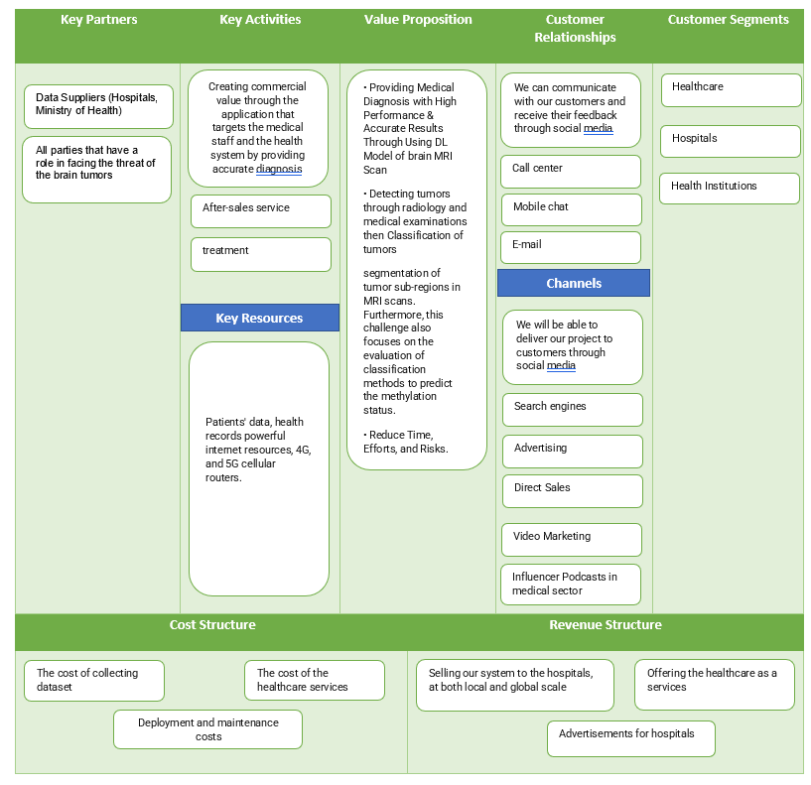

Slide 19
05
Fifth
SECTION

Slide 20
USER INTERFACE
05

Slide 21
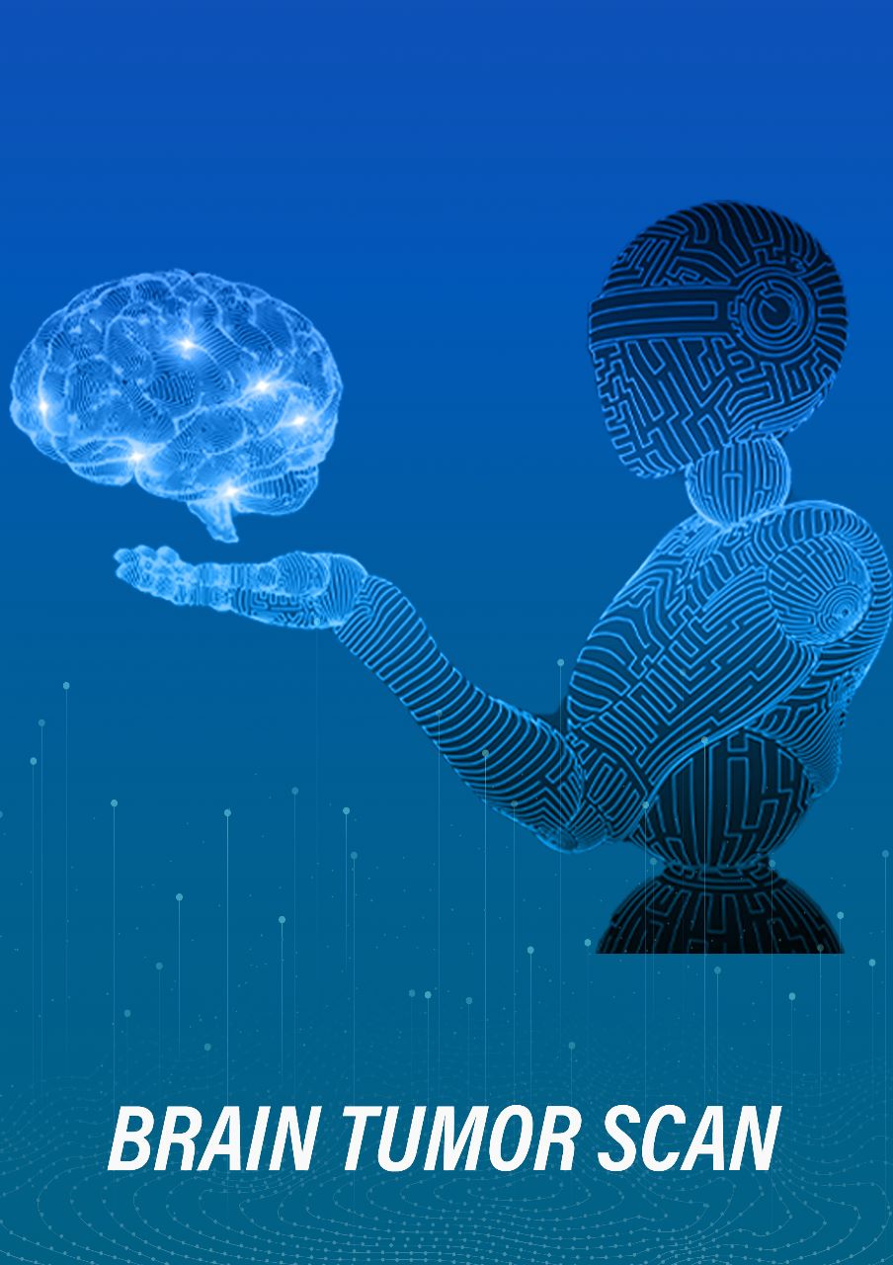
MOBILE APP
An application to diagnose brain tumors in union with artificial intelligence and this application development by flutter

Slide 22
In the beginning, we used firebase to create an account, log in with an email and password, and save user data
Then connect the application to the model using the flask method to diagnose the tumor by raising the MRI scan
Then show the result of the tumor as a type and determine its location
➔Each patient has his own file containing all his MRI, the date of upload and the MRI results

Slide 23
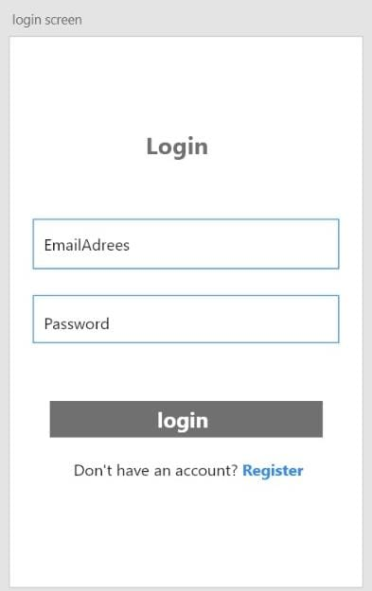
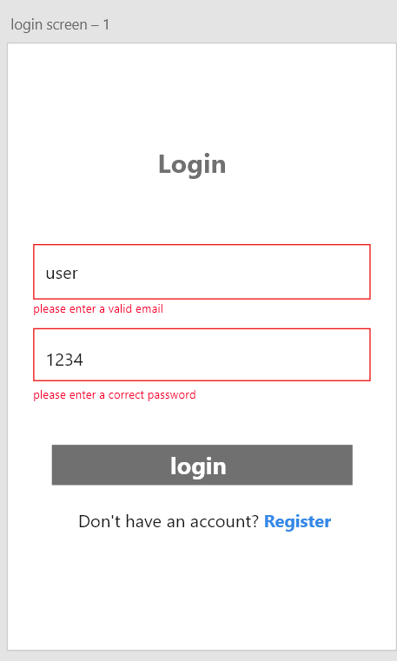
The user logs in with the email and password if he has an account, and if he does not have an account, he goes to the registration page
If the user entered wrong data

Slide 24
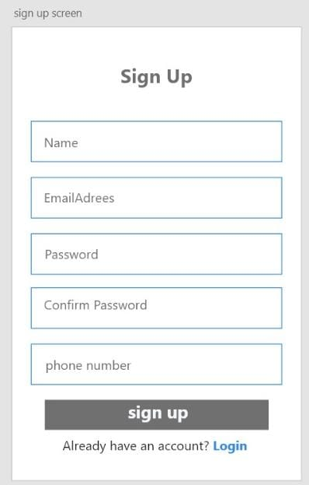
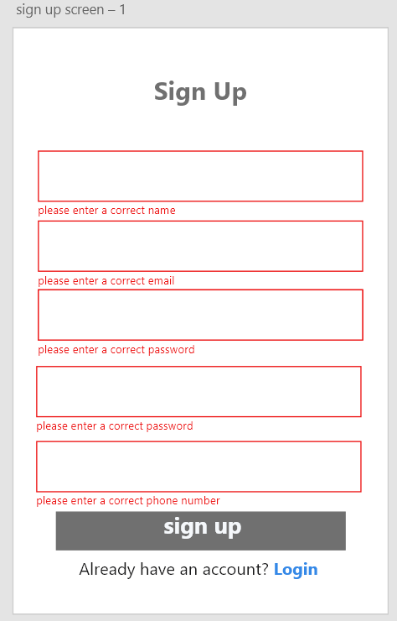
This is the registration page to create an account by filling in all the data and confirming it, then it goes to the login page and then to the home page
If the user entered wrong data

Slide 25
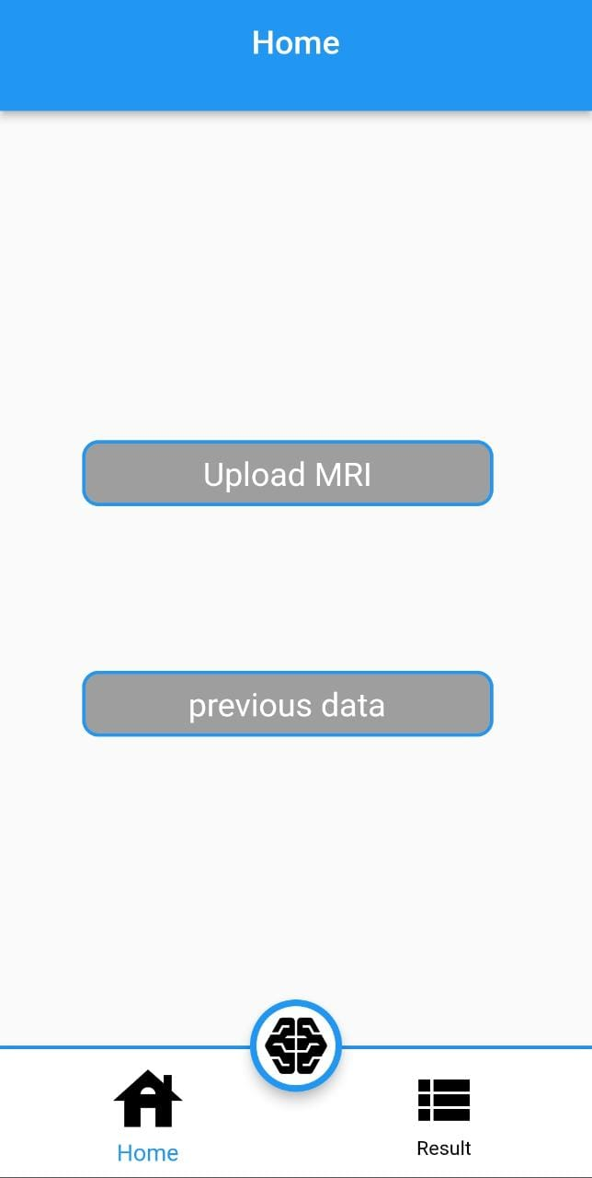
The home page contains two options, the first to upload MRI, and the second to show previous cases

Slide 26
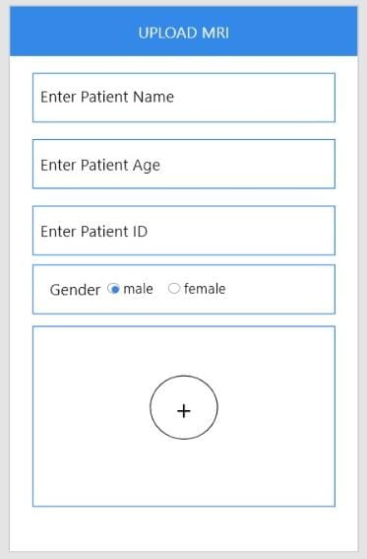
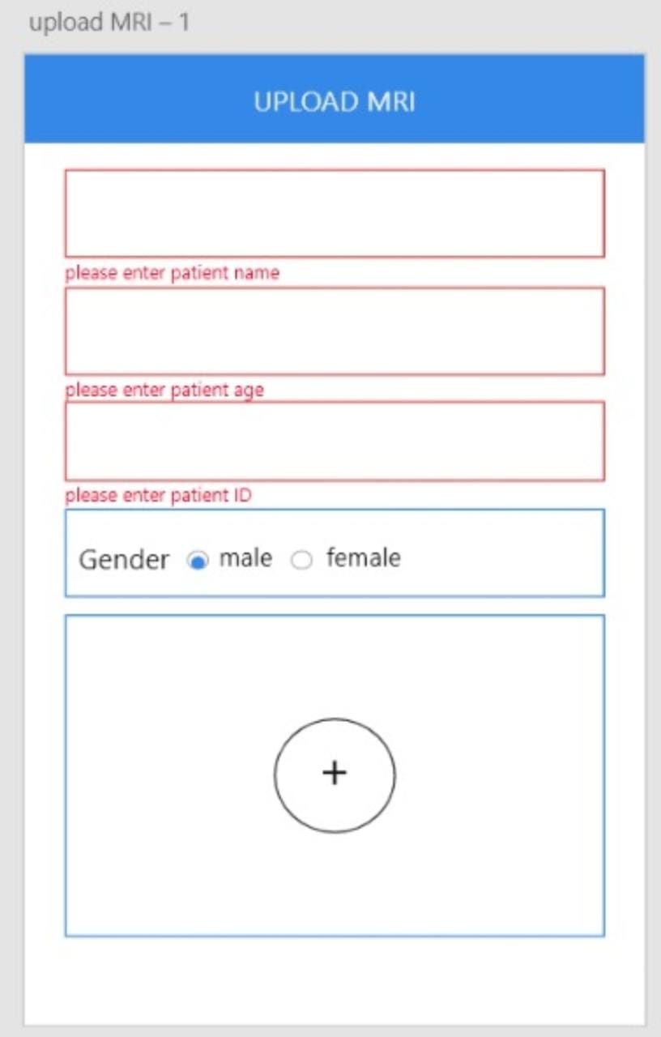
entering the patient's name, age and gender. It is not allowed to upload the image before filling in the data.
Then it goes to the processing screen

Slide 27
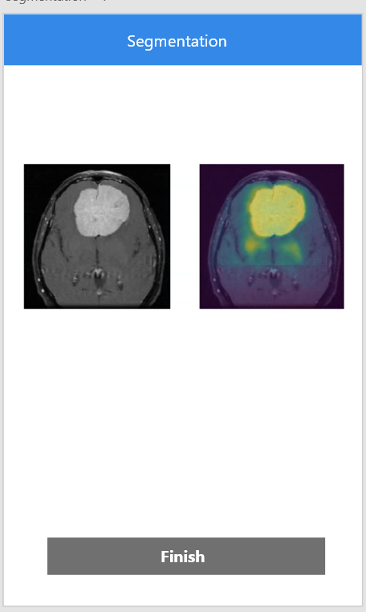
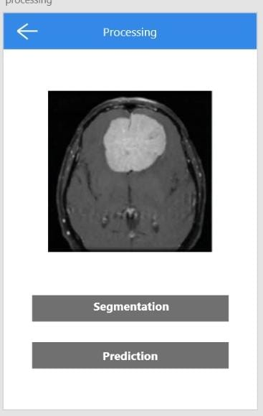
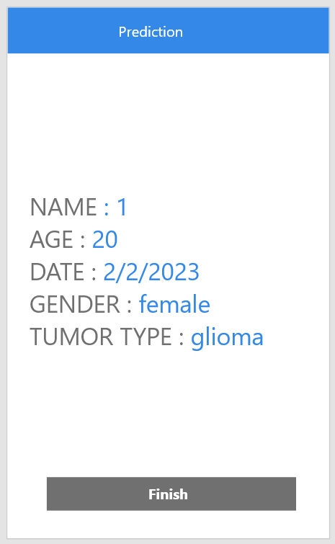
The processing screen contains two options to show segmentation or prediction

Slide 28
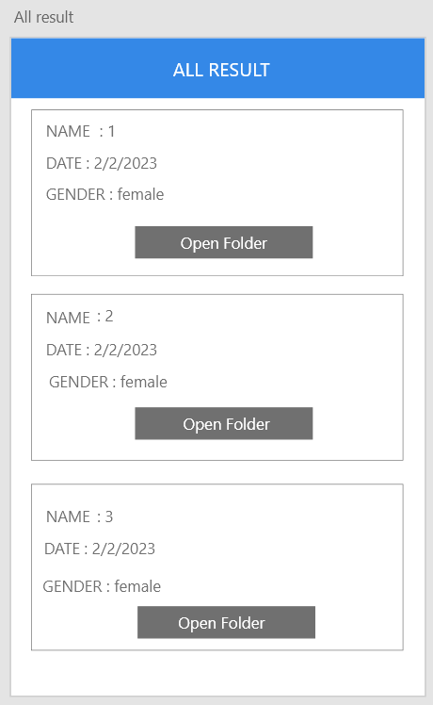
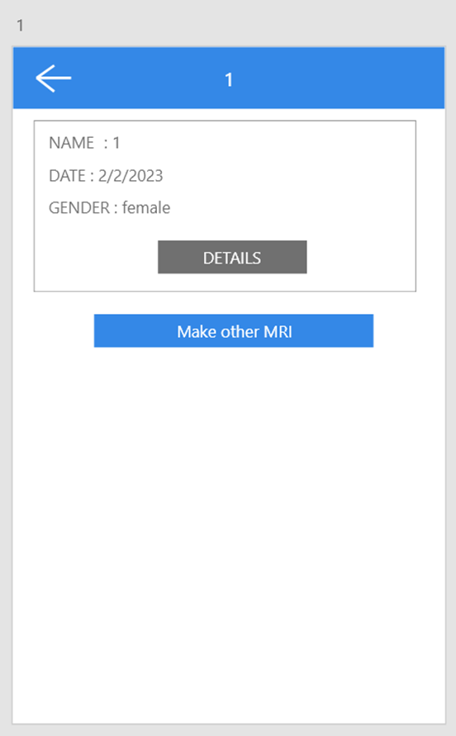
If choose show previous cases , All results screen appears

Slide 29

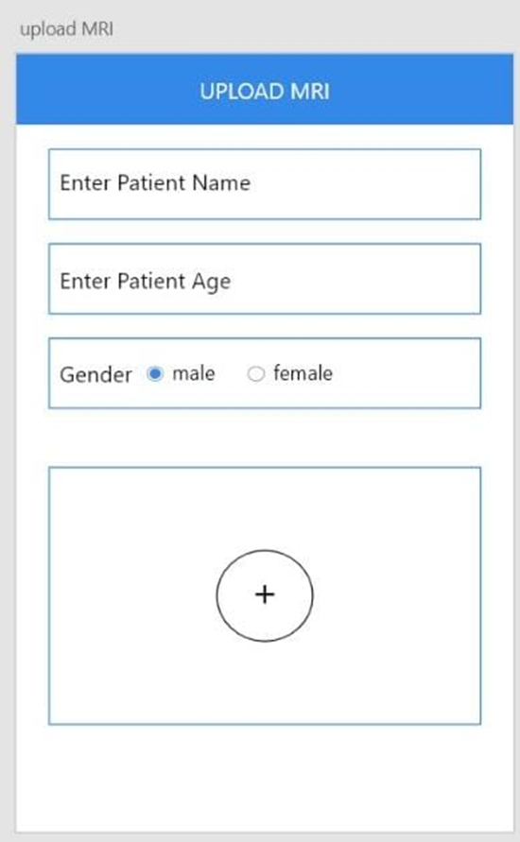
When choosing to open the file, all MRI related to the person appear

Slide 30
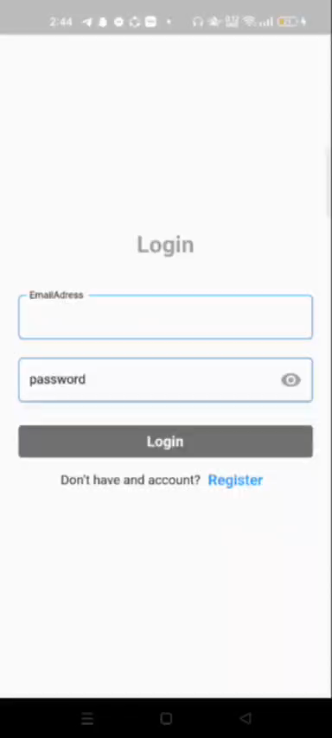
DEMO

Slide 31
06
FUTURE WORK

Slide 32
OUR PLANS
Multi-class Segmentation
Dataset
Exactly delimitate objects, once they are detected.
contribute real dataset
MRI scan were collected from nearly 250 cases
Semantic Segmentation
Instance Segmentation
we used U-net model for semantic segmentation to allocate ROI
Segment tumor core, Tumor cortex, and whole tumor

Slide 33
Google Technologies
Flutter
Firebase
Tensorflow

Slide 34
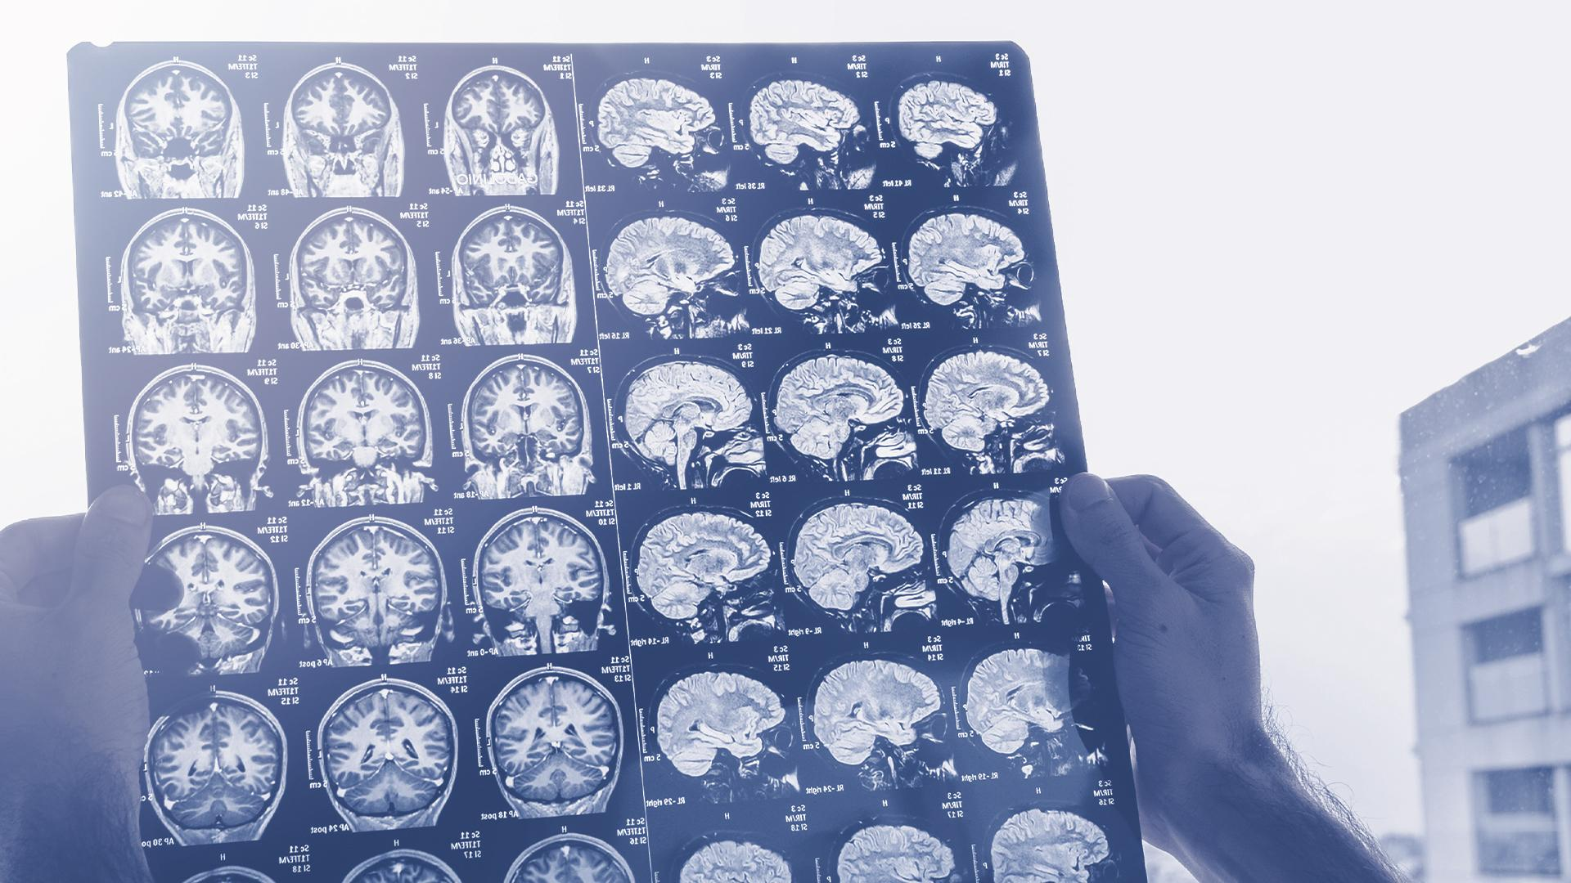
THANKS!
Do you have any questions?

